Slide 1


Melbourne AirBnB
2019 vs 2020
Sherin, Neena & Cody

Slide 2

Project Brief
Our project aimed to look at available data for Melbourne AirBnB listings across 2019 and 2020 to identify trends in availability, room types offered post-COVID and whether price or other factors affect bookings and review score.
Specifically, we looked at:
Which Melbourne areas have the most AirBnB listings
Which Melbourne areas see the most bookings
What room types does AirBnB have in Melbourne
How does the price of these room types vary across areas
Does price correlate to a high review score
Does price correlate to the number of nights a property is booked
Does a host responding to messages correlate to the number of nights their property is booked

Slide 3

Data Used
There were two datasets used for this project:
https://www.kaggle.com/tylerx/melbourne-airbnb-open-data
This dataset was compiled from the Inside AirBnB website on 7 December 2018
It shows all active listings for AirBnB and the next 12 months of their calendar (i.e. availability in 2019 for the properties)
It also contains a range of summary data and other information about the host
https://www.kaggle.com/nadyafed/melbourne-airbnb-2020
This dataset was also compiled from the Inside AirBnB website, this dataset was created on 20 August 2020
Inside AirBnB - http://insideairbnb.com/get-the-data.html
Inside AirBnB Data Dictionary - https://docs.google.com/spreadsheets/d/1iWCNJcSutYqpULSQHlNyGInUvHg2BoUGoNRIGa6Szc4/edit#gid=982310896

Slide 4
Why This Project & Data?
All three of our group have used AirBnB in Melbourne at some point in our lives, with a maximum stay of 1 month. We have also experienced the COVID lockdowns ad were interested to see the impact the hard lockdown and closed borders would have on a business with the model of AirBnB.
We expected to see:
Melbourne City having the largest volume of listings
Melbourne City having the least availability in each listing across 2019/2020
A decrease in listings from 2019 to 2020, especially in Entire Homes/Apartments and in Shared Rooms
A relationship between price per night and number of days booked, lower nightly price to more days booked

Slide 5
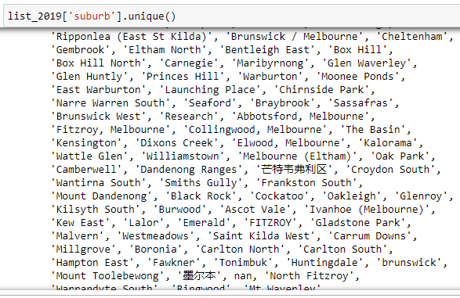
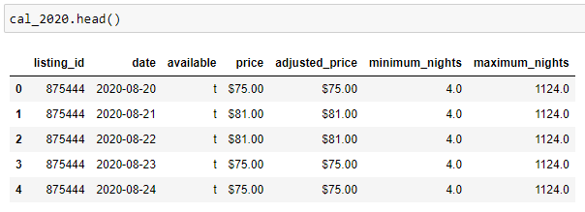
Title
Limitations of the Datasets
The largest limitation of the available data is that it’s a snapshot only. AirBnB did not have available ongoing historical data for public use, and that would have been too large to work with, so our data has two different start dates rather than looking at identical moments in time.
The second large limitation was the amount of data entered by the AirBnB hosts themselves. As a web-scraped set of data, there is a large volume of data which needed to be removed as it caused inaccuracies.
Availability is given as a True/False in the AirBnB calendar. However, while we assume False to be a booking, it can also indicate that the listing was made unavailable by the host during those dates.
Pricing data presents extreme outliers within the dataset, this is likely because some bookings are only made available for long term stays, but their host has listed that price as the daily price.

Slide 6
Which Melbourne Areas have the most AirBnB listings
Local Government Area | 2019 Listings | 2020 Listings | Change in Listings from 2020 and 2019
Melbourne | 7368 | 6174 | -1194
Port Phillip | 2808 | 2498 | -310
Yarra | 2049 | 1578 | -471
Stonnington | 1621 | 1369 | -252
Moreland | 967 | 863 | -104
The top 5 local government areas in the 2019 data were:
Melbourne
Port Phillip
Yarra
Stonnington
Moreland
These also remained the most populated with listings in the 2020 data, as seen in the table on the right.
The total 2019 listings were 22,895 and 2020 had 20,420.
This means that AirBnB lost 2,475 listings between the two data scrapes.

Slide 7
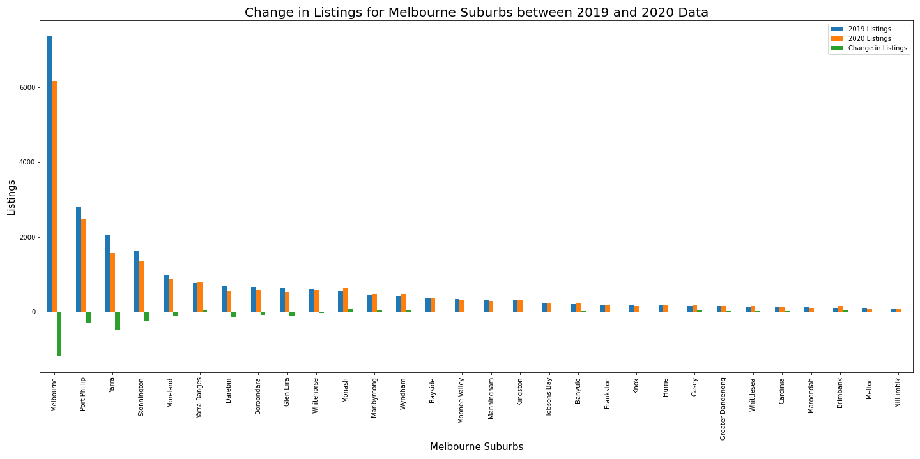

Slide 8
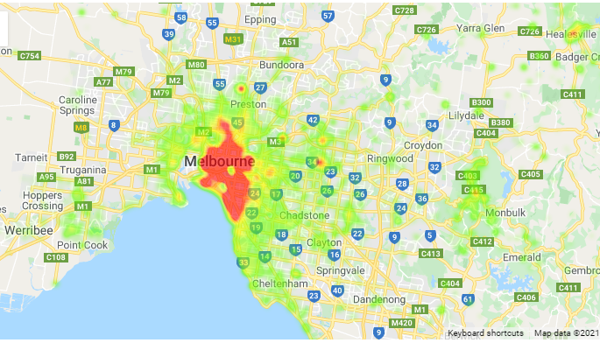
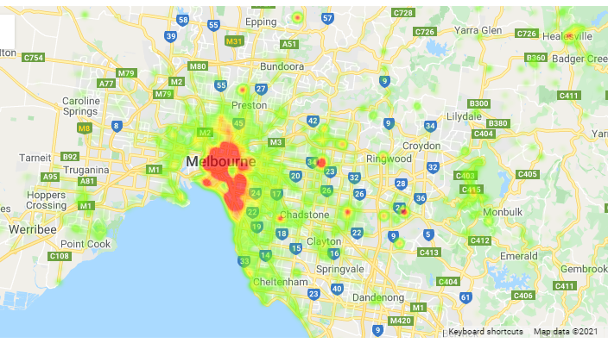
Listings – Heatmap of Prices
2019
2020

Slide 9
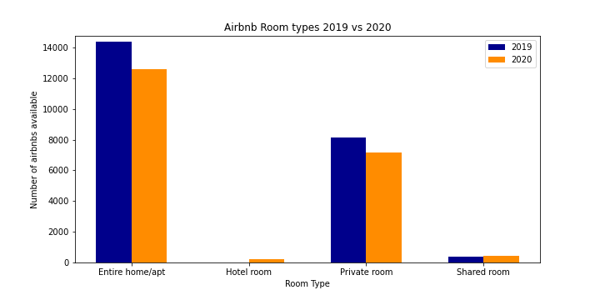
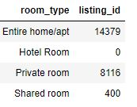
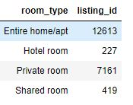
Airbnb Room Types for 2019 and 2020
10 % overall decrease in Airbnb listings in 2020 Total listings in 2019 : 22,895 Total listings in 2020 : 20,420
Majority of listings are under type Entire Home/ Apartment for both years 2019 and 2020.
Entire Home/ Apartment and Private Rooms listings have decreased. Shared rooms listings have slightly increased.
Hotel Rooms introduced as Airbnb listing in 2020
Room Listings for 2019
Room Listings for 2020

Slide 10
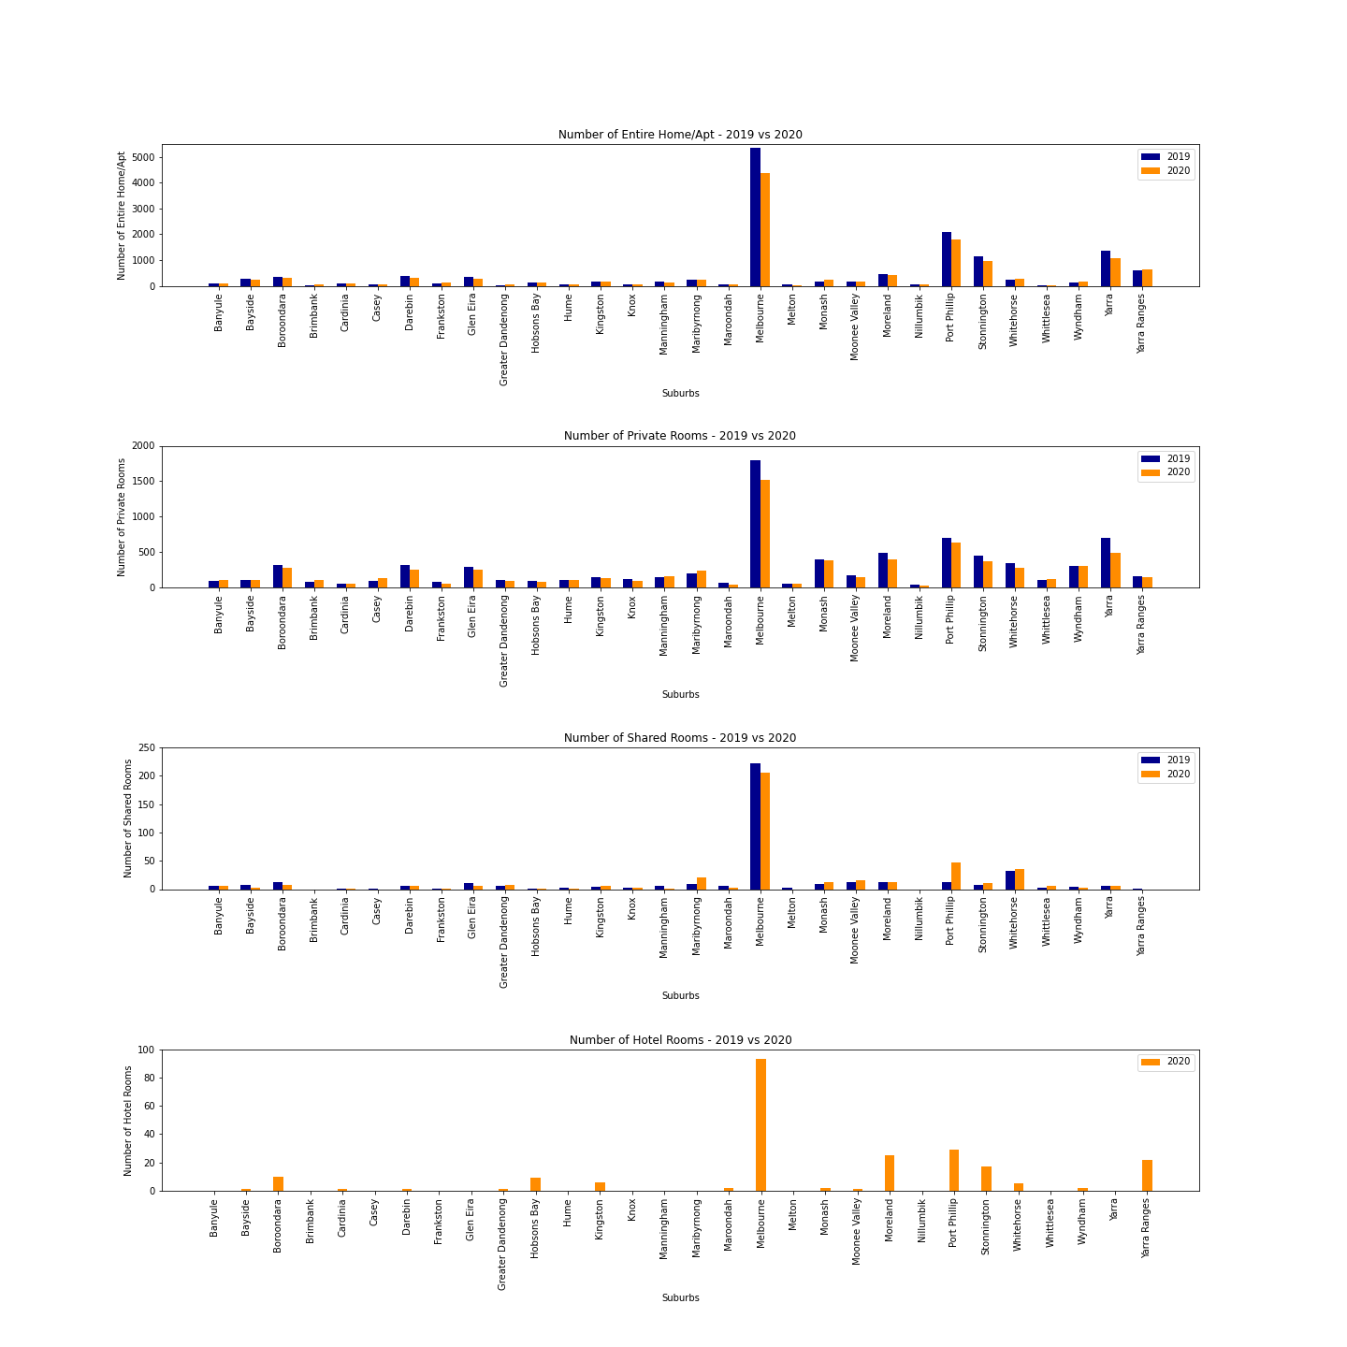
AirBnb Room Types for CIties
Maximum overall listings in City of Melbourne.
Top 3 Cities with Entire Homes/Apartments and Private Rooms for years 2019 and 2020 Melbourne, Port Philip, Yarra
Shared Rooms: Port Philip and Whitehorse listings slightly increased in year 2020
Hotel Rooms has most listings in Melbourne, Port Philip and Yarra Ranges

Slide 11
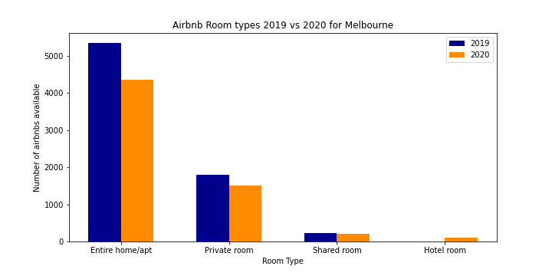
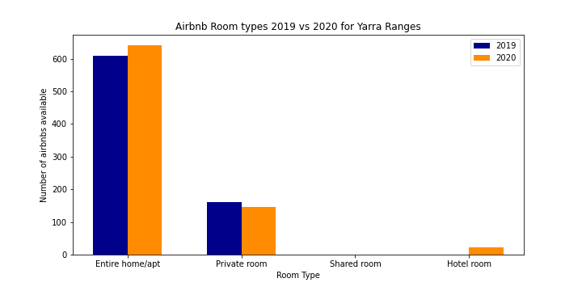
Regional vs MELBOURNE City Listings
Comparison of Airbnb listings between city of Melbourne and Regional areas
Yarra Ranges had a slight increase in Entire Home listings
Melbourne had an overall decrease in listings across all room types
Examples for City of Melbourne and Yarra Ranges

Slide 12
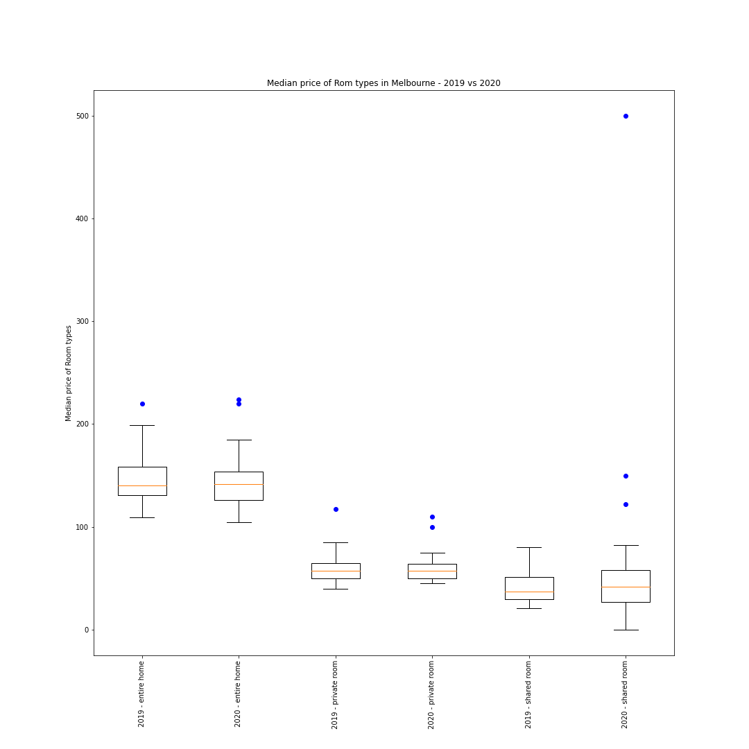
Airbnb Listings Price Comparison
Median prices for room types across Melbourne have slightly increased or remained the same in 2020

Slide 13
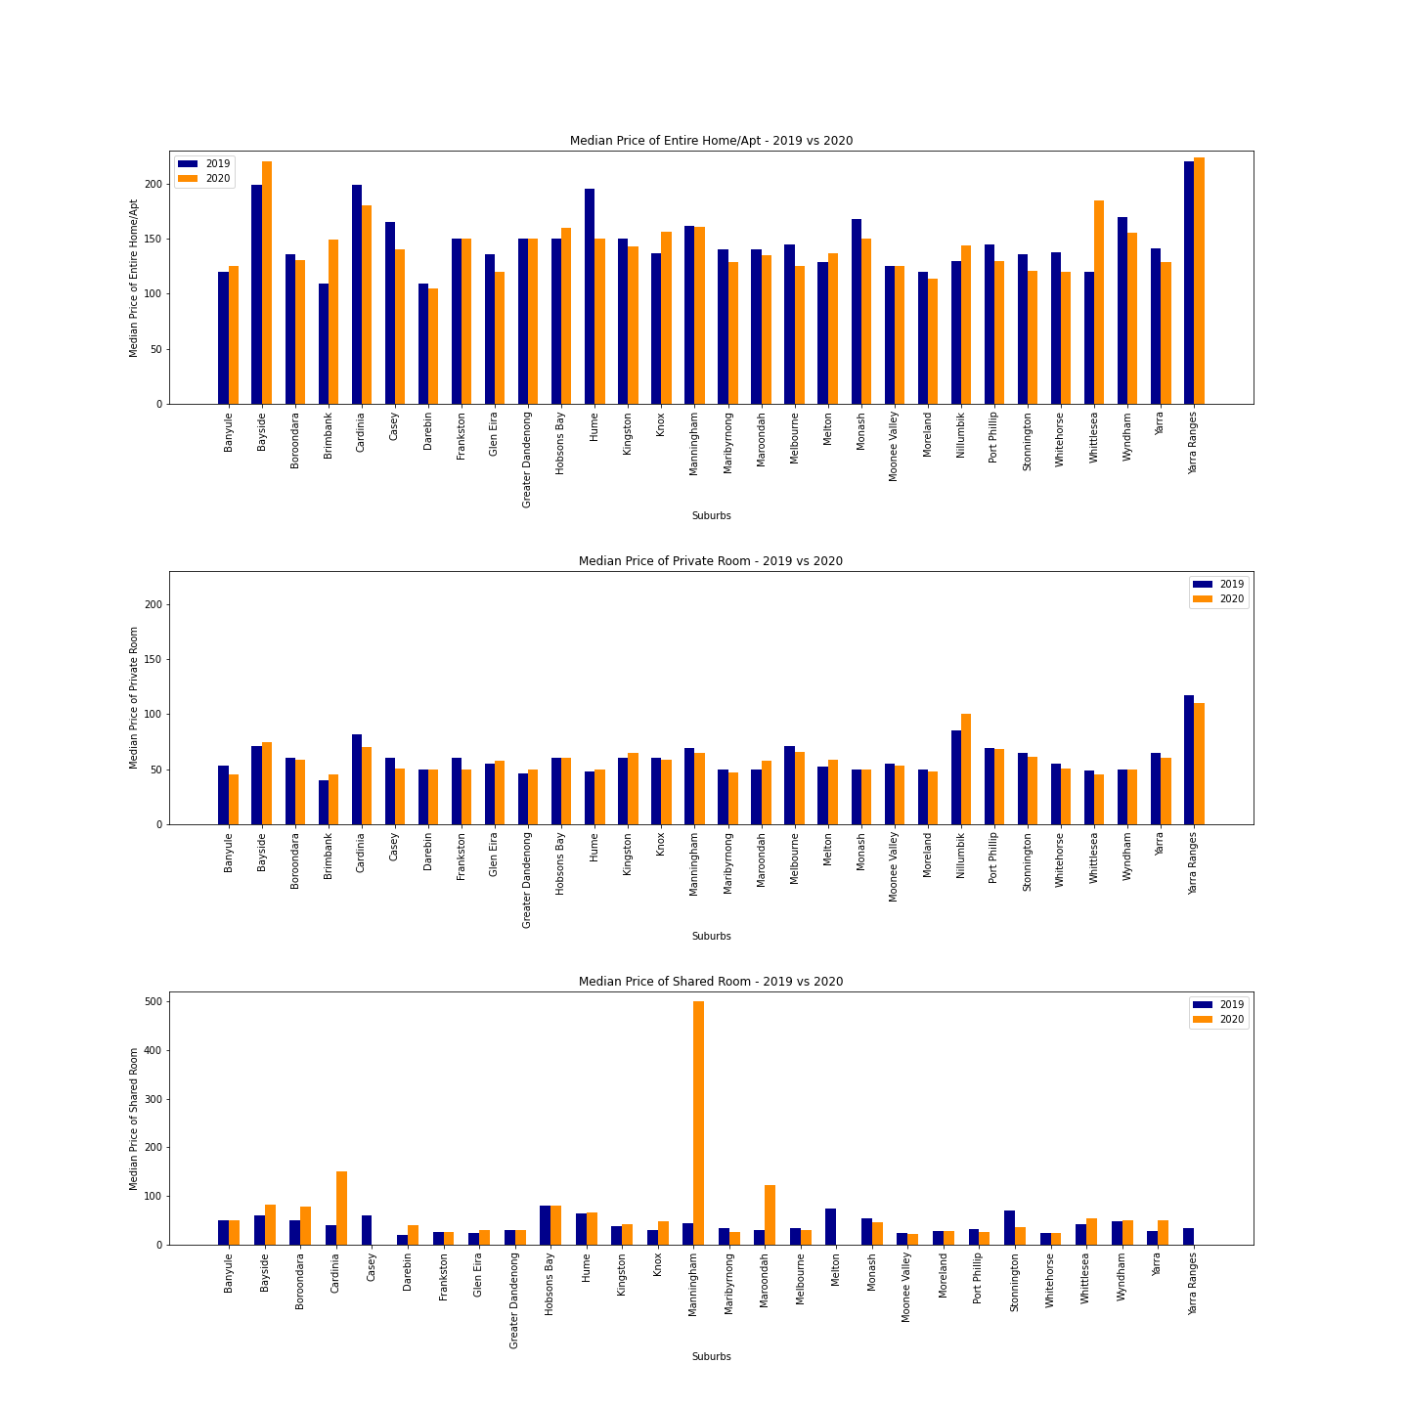
Airbnb Listings Price Comparison FOR CITIES
Entire Home prices in Yarra Ranges and Bayside have increased in 2020.
Shared room price in city of Mannigham shows an increase in price in 2020, however this is for a single listing.

Slide 14
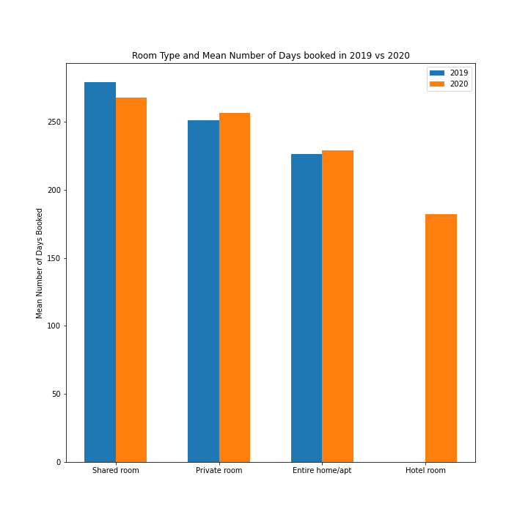
Number of rooms booked per year
Number of shared rooms booked have been reduced in 2020.
This could be an after effect of Covid.

Slide 15
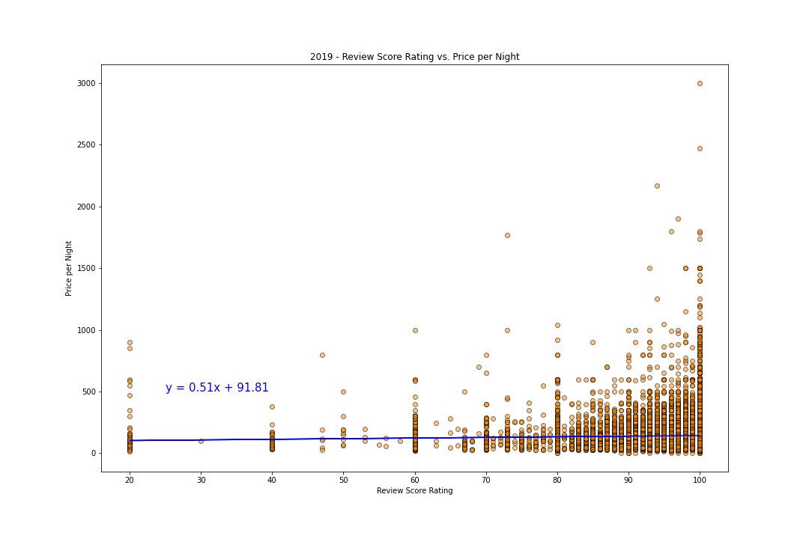
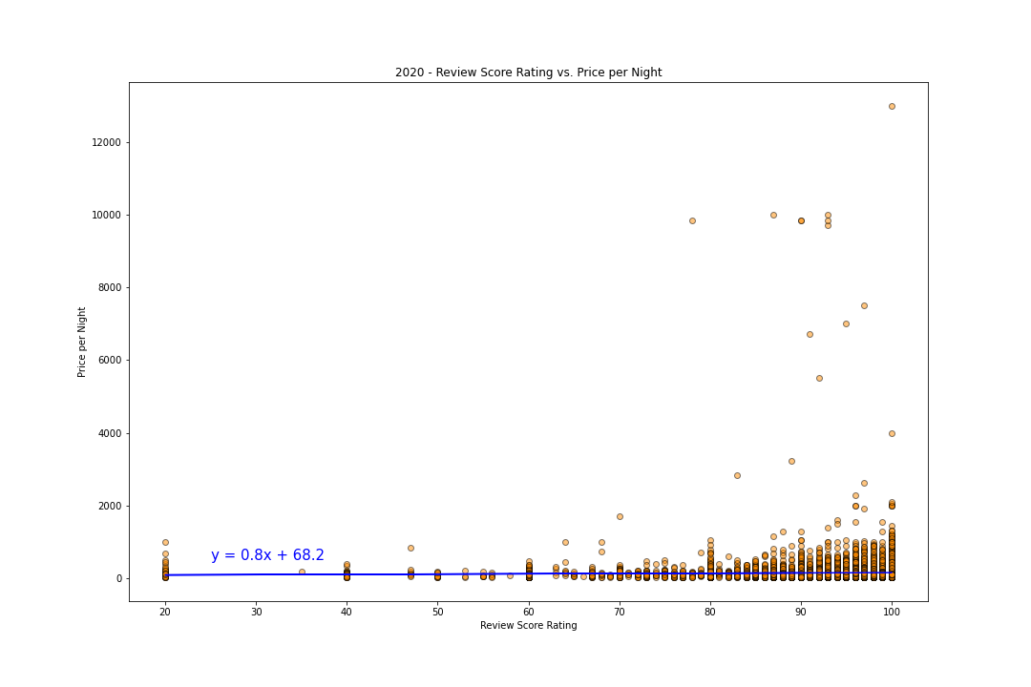
Review Score vs Price
2019 – r value is 0.04
2020 – rvalue is 0.03
There is only weak correlation between Review rating and Price per Night of a listing in AirBnB.

Slide 16
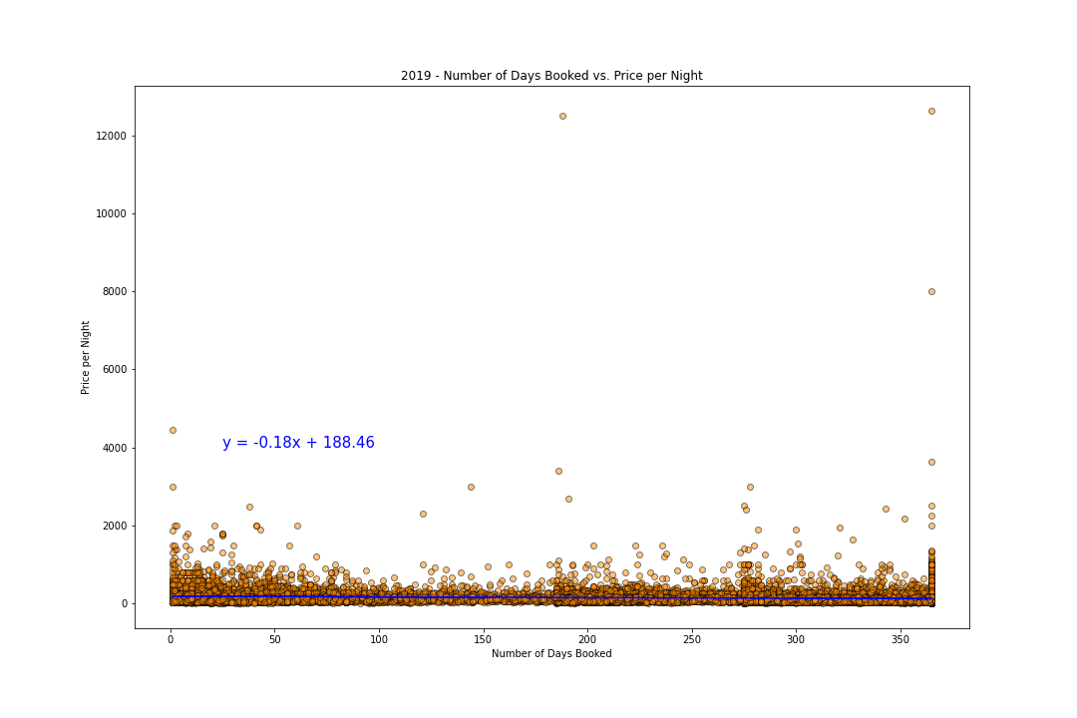
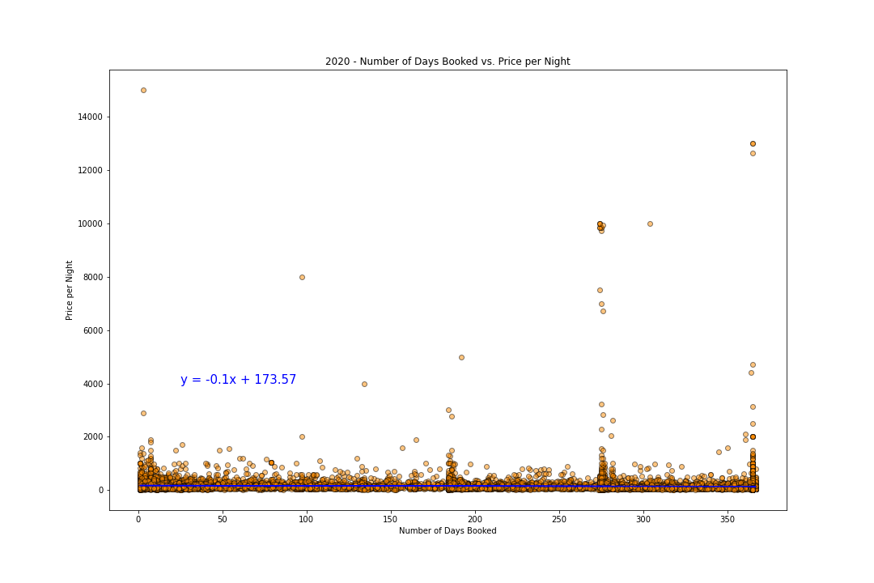
Price per Night vs Number of Days Booked
2019 – r value is -0.11
2020 – r value is -0.04
There is only weak correlation between Price per Night and Number of days booked for a listing in AirBnB.

Slide 17
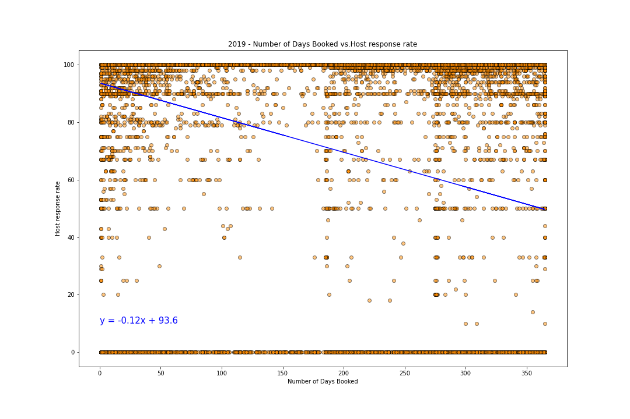
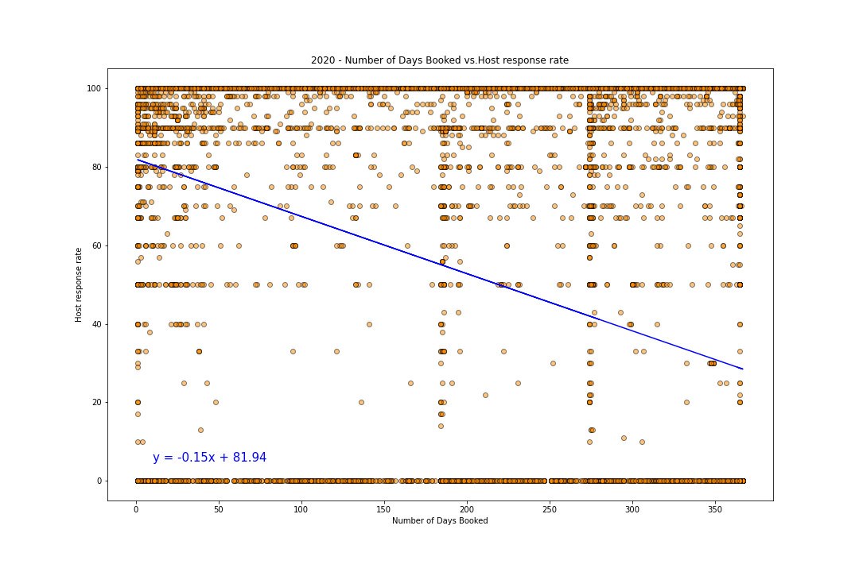
Host Response Rate vs Number of Days Booked
2019 – r value is -0.34
2020 – r value is -0.4
There is moderate negative correlation between Host Response Rate and Number of Days booked for a listing in AirBnB.
This was not expected and one of the reason for negative correlation could be the increased responses required with increased bookings.

Slide 18

Title:
Final Comments
We will also take questions.

Slide 19

THANK YOU
GitHub Link: https://github.com/cjdance/Project_1.git

